Slide 1
Presentation 17
Corrective and preventive actions
Corrective and preventive actions — definitions
The corrective and preventive actions process
Information collection
Analysis of collected information
Development of solutions and their implementation
Follow-up of activities
Organizing for preventive and corrective actions

Slide 2
Corrective and
preventive actions - definitions
Corrective actions
A regularly applied feedback process that includes collection of information on quality non-conformities, identification and analysis of sources of irregularities as well as development and assimilation of improved practices and procedures, together with control of their implementation and measurement of their outcomes.
Preventive actions
A regularly applied feedback process that includes collection of information on potential quality problems, identification and analysis of departures from quality standards, development and assimilation of improved practices and procedures, together with control of their implementation and measurement of their outcomes.

Slide 3
Sources of CAPA information
Quality records
Service reports
Internal quality audits
Project risk reviews
Software risk management reports
….

Slide 4
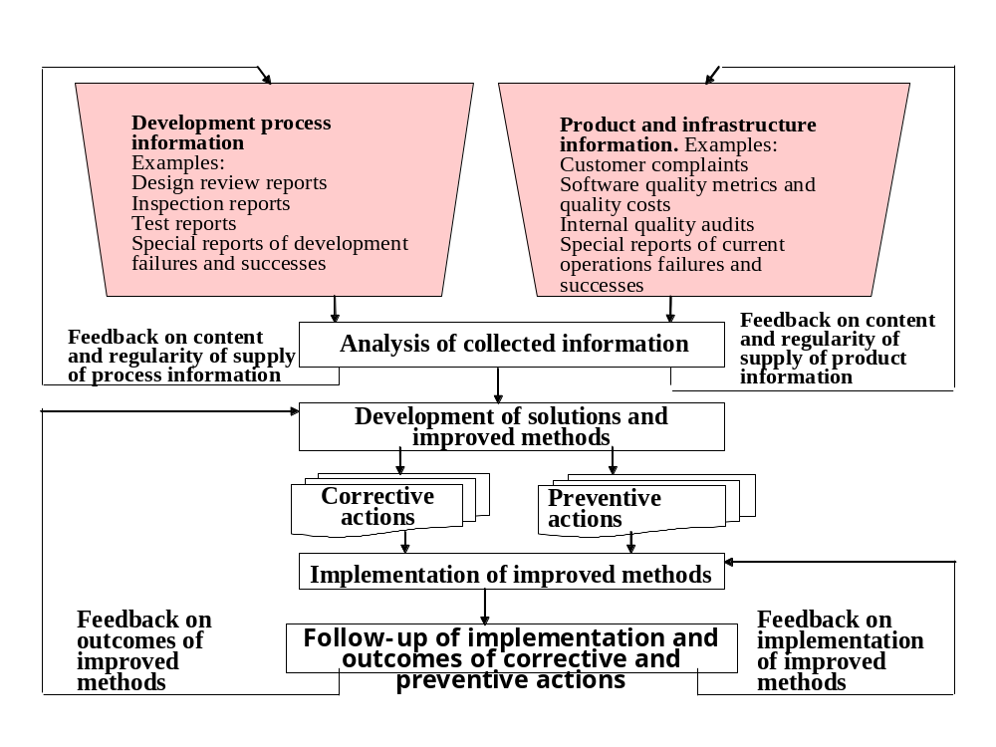
The corrective and
preventive action process

Slide 5
Sources of
CAPA information
Internal information sources
Software development process
* Software risk management reports
* Design review reports
* Inspection reports
* Walkthrough reports
* Experts opinion reports
* Test reviews
* Special reports on development failures and
successes
* Proposals suggested by staff members
Software maintenance
* Customer applications statistics
* Software change requests initiated by
customer applications
* Software change requests initiated by
maintenance staff
* Special reports on maintenance failures and
successes
* Proposals suggested by staff members
SQA infrastructure class of sources
* Internal quality audit reports
* External quality audit reports
* Performance follow-up of trained and
certified staff
* Proposals suggested staff members
Software quality management procedures class of sources
* Project progress reports
* Software quality metrics reports
* Software quality cost reports
* Proposals of staff members
External information sources
* Customer complaints
* Customer service statistics
* Customer-suggested proposals

Slide 6
Corrective actions
board (CAB) – the tasks
* Collecting CAPA records from the various sources.
* Screening the collected information.
* Nominating ad hoc CAPA teams to attend to given subjects or head the teams.
* Promoting implementation of CAPA
* Following up information collection, data analysis, progress made by ad hoc teams, implementation as well as outcomes of improved CAPA methods.

